Slide 1
Chapter 13
Order Fulfillment, eCRM,
and Other Support Services

Slide 2
Learning Objectives
Describe the role of support services in EC.
Define EC order fulfillment and describe the EC order fulfillment process.
Describe the major problems of EC order fulfillment.
Describe various solutions to EC order fulfillment problems.
Describe CRM, its methods, and its relationship with EC.
Describe eCRM implementation and tools.
Describe other EC support services.
Discuss the drivers of outsourcing support services.

Slide 3
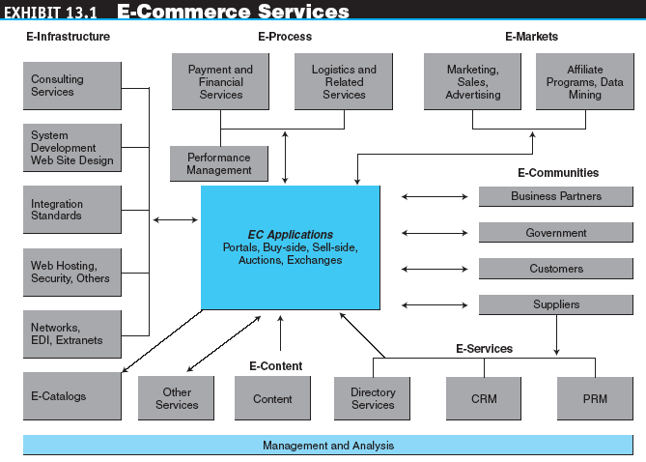
Order Fulfillment and Logistics:
An Overview

Slide 4
Order Fulfillment and Logistics:
An Overview
order fulfillment
All the activities needed to provide customers with their ordered goods and services, including related customer services
back-office operations
The activities that support fulfillment of orders, such as packing, delivery, accounting, and logistics

Slide 5
Order Fulfillment and Logistics:
An Overview
front-office operations
The business processes, such as sales and advertising, that are visible to customers
logistics
The operations involved in the efficient and effective flow and storage of goods, services, and related information from point of origin to point of consumption

Slide 6
Order Fulfillment and Logistics:
An Overview
The EC Order Fulfillment Process
  Activity 1: Making sure the customer will pay
  Activity 2: Checking for in-stock availability
  Activity 3: Arranging shipments
  Activity 4: Insurance
  Activity 5: Replenishment
  Activity 6: In-house production
  Activity 7: Use contractors
  Activity 8: Contacts with customers
  Activity 9: Returns
    reverse logistics
    The movement of returns from customers to vendors

Slide 7
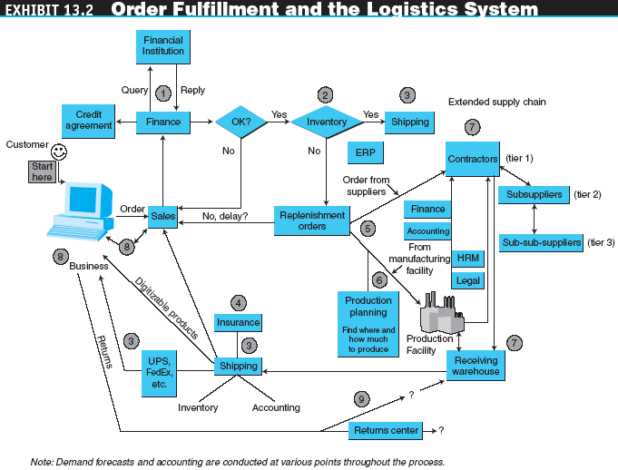
Order Fulfillment and Logistics:
An Overview

Slide 8
Order Fulfillment and Logistics:
An Overview
The administrative activities of order taking and fulfillment:
Product inquiry
Sales quote
Order configuration
Order booking
Order acknowledgment or confirmation
Order sourcing or planning
Order changes
Shipment release
Shipment
Delivery
Invoicing and billing
Settlement
Returns

Slide 9
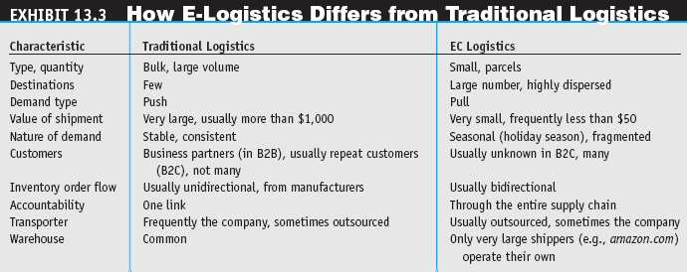
Order Fulfillment and Logistics:
An Overview

Slide 10
Order Fulfillment and Logistics:
An Overview
Order fulfillment and the supply chain
Traditional versus EC logistics
  e-logistics
  The logistics of EC systems, typically involving small parcels sent to many customers’ homes (in B2C)

Slide 11
Problems in Order Fulfillment
Typical Supply Chain Problems
  Inability to deliver products on time
  High inventory costs
  Quality problems
  Shipments of wrong products, materials, and parts
  Cost to expedite operations or shipments is high

Slide 12
Problems in Order Fulfillment
Why Supply Chain Problems Exist
  Many problems along the EC supply chain stem from uncertainties and from the need to coordinate several activities, internal units, and business partners
  The major source of the uncertainties is the demand forecast
  Other uncertainties variable delivery times and quality problems
  Lack of coordination and an inability or refusal to share information among business partners
  Lacking the internal logistics infrastructure companies use:
  third-party logistics suppliers (3PL)
  External, rather than in-house, providers of logistics services

Slide 13
Solutions to
Order Fulfillment Problems
Improvements in the Order-Taking Process
Warehousing and Inventory Management Improvements
  warehouse management system (WMS)
  A software system that helps in managing warehouses

Slide 14
Solutions to
Order Fulfillment Problems
  Other inventory management improvements
    Reducing inventory and decreasing the incidence of out-of-stocks
    Maintaining an inventory of repair items
    Picking items out of inventory in the warehouse
    Communicating
    Managing product inventory
    Receiving items at the warehouse automating the warehouse
  Automated warehouses
  Using wireless technologies
    Using RFID to improve WMS

Slide 15
Solutions to
Order Fulfillment Problems
Speeding Deliveries
  Same day, even same hour, delivery
  Supermarket deliveries
  A speedier superstore using a drive-in model
  Failed delivery companies

Slide 16
Solutions to
Order Fulfillment Problems
Partnering Efforts And Outsourcing Logistics
  Comprehensive logistics services
  Outsourcing logistics
Integrated Global Logistics Systems
  The number of partners in such situations is larger as is the need for coordination, communication, and collaboration and a high level of security in the Internet environment

Slide 17
Solutions to
Order Fulfillment Problems
Handling Returns (Reverse Logistics)
  Return the item to the place of purchase.
  Separate the logistics of returns from the logistics of delivery
  Completely outsource returns
  Allow the customer to physically drop the returned item at a collection station
  Auction the returned items

Slide 18
Solutions to
Order Fulfillment Problems
Order Fulfillment in B2B
  Using BPM to improve order fulfillment
  Using e-marketplaces and exchanges to ease order fulfillment
  Order fulfillment in services

Slide 19
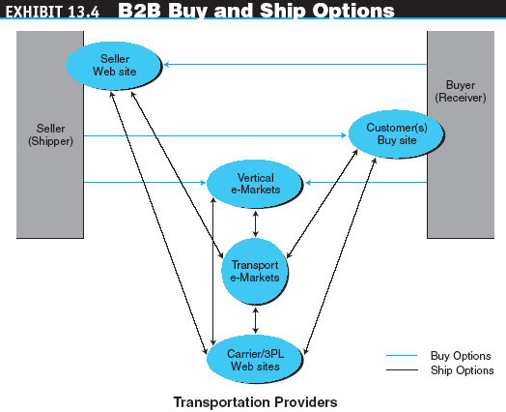
Solutions to
Order Fulfillment Problems

Slide 20
Solutions to
Order Fulfillment Problems
Innovative E-Fulfillment Strategies
  merge-in-transit
  Logistics model in which components for a product may come from two (or more) different physical locations and are shipped directly to the customer’s location
  rolling warehouse
  Logistics method in which products on the delivery truck are not preassigned to a destination, but the decision about the quantity to unload at each destination is made at the time of unloading

Slide 21
CRM and Its Relationship with EC
customer relationship management (CRM)
A customer service approach that focuses on building long-term and sustainable customer relationships that add value both for the customer and the selling company

Slide 22
CRM and Its Relationship with EC
Types and Classification of CRM
  Loyalty programs
  Prospecting
  Save or win back
  Cross-sell or up-sell
eCRM
Customer relationship management conducted electronically

Slide 23
CRM and Its Relationship with EC
The Scope of CRM
  Three levels of CRM
    Foundation services
    Customer-centered services
    Value-added services
  The extent of service
    Customer acquisition (prepurchase support)
    Customer support during purchase
    Customer fulfillment (purchase dispatch)
    Customer continuance support (postpurchase)

Slide 24
CRM and Its Relationship with EC
Benefits and Limitations of CRM
  Major benefit of CRM is the provision of superior customer care through the use of the Internet and IT technologies
  Major limitation of CRM is that it requires integration with a company’s other information systems

Slide 25
CRM and Its Relationship with EC
CRM Implementation Issues
  Steps in building a customer-centered EC strategy:
    Focus on the end customer
    Systems and business processes designed for ease of use and from the end customer’s point of view
    Efforts to foster customer loyalty

Slide 26
CRM and Its Relationship with EC
  Actions necessary to implement this strategy
    Deliver personalized services
    Target the right customers
    Help customers do their jobs
    Let customers help themselves
    Streamline business processes that impact customers
    Own the customer’s total experience by providing every possible customer contact
    Provide a 360-degree view of the customer relationship

Slide 27
CRM and Its Relationship with EC
Five factors required to implement a CRM program effectively:
  Customer-centric strategy
  Commitments from people
  Improved or redesigned processes
  Software technology
  Infrastructure

Slide 28
CRM and Its Relationship with EC
Integrating CRM into the Enterprise
Justifying Customer Service and CRM Programs
  Metrics in customer service and CRM
  metrics
  Performance standards; may be quantitative or qualitative

Slide 29
CRM and Its Relationship with EC
  Web-related metrics used to determine the appropriate level of customer support:
    Response time
    Site availability
    Download time
    Timeliness
    Security and privacy
    On-time order fulfillment
    Return policy
    Navigability

Slide 30
CRM and Its Relationship with EC
  eCRM Analytics
    analytic CRM
    Applying business analytics techniques and business intelligence such as data mining and online analytic processing to CRM applications

Slide 31
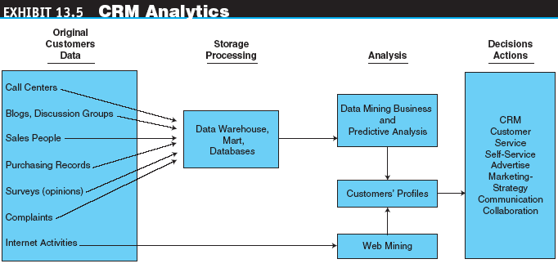
CRM and Its Relationship with EC

Slide 32
CRM and Its Relationship with EC
Future Directions of CRM
  The customer experience with products, services, and the company providing them will be the foundation for CRMs going forward
  “CRM On-Demand” will become preeminent
  The open source movement will become a credible competition to the on-demand market
  CRM will be integrated increasingly with strategies for social networking and at the application level

Slide 33
Delivering Customer Service in Cyberspace: CRM Applications and Tools
Classifications of CRM Applications
  Customer-facing applications
  Customer-touching applications
  Customer-centric intelligence applications
  Online networking and other applications

Slide 34
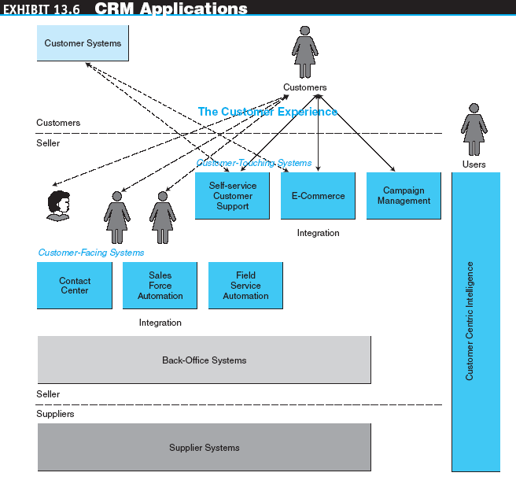
Delivering Customer Service in Cyberspace: CRM Applications and Tools

Slide 35
Delivering Customer Service in Cyberspace: CRM Applications and Tools
Customer-Facing Applications
  customer interaction center (CIC)
  A comprehensive service entity in which EC vendors address customer-service issues communicated through various contact channels
  telewebs
  Call centers that combine Web channels with portal-like self-service

Slide 36
Delivering Customer Service in Cyberspace: CRM Applications and Tools
  Intelligent agents in customer service and call centers
  Automated response to e-mail
    autoresponders
    Automated e-mail reply systems (text files returned via e-mail) that provide answers to commonly asked questions

Slide 37
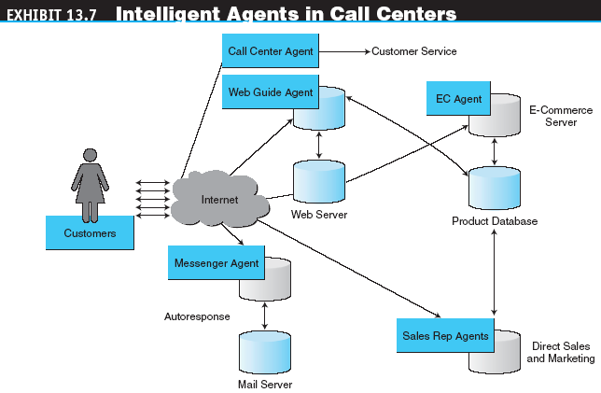
Delivering Customer Service in Cyberspace: CRM Applications and Tools

Slide 38
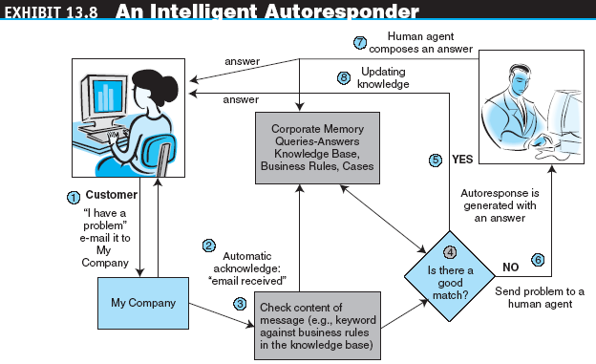
Delivering Customer Service in Cyberspace: CRM Applications and Tools

Slide 39
Delivering Customer Service in Cyberspace: CRM Applications and Tools
sales force automation (SFA)
Software that automates the tasks performed by salespeople in the field, such as data collection and its transmission
  Field service automation

Slide 40
Delivering Customer Service in Cyberspace: CRM Applications and Tools
Customer-Touching Applications
  Personalized Web Pages
  E-Commerce Applications
  Web self-service
  Activities conducted by users on the Web to find answers to their questions (e.g., tracking) or for product configuration

Slide 41
Delivering Customer Service in Cyberspace: CRM Applications and Tools
  Web self-service
    Self-tracking
    Customer self-service through FAQs
      FAQ page
      A Web page that lists questions that are frequently asked by customers and the answers to those questions
    Self-configuration and customization

Slide 42
Delivering Customer Service in Cyberspace: CRM Applications and Tools
Customer-Centric Applications
  Data reporting and warehousing
    Data reports
    data warehouse
    A single, server-based data repository that allows centralized analysis, security, and control over the data
  Data analysis and mining

Slide 43
Delivering Customer Service in Cyberspace: CRM Applications and Tools
Online Networking
  Forums
  Chat rooms
  Usenet groups
  Blogs and Wikis
  E-mail newsletters
  Discussion lists

Slide 44
Delivering Customer Service in Cyberspace: CRM Applications and Tools
mobile CRM
The delivery of CRM applications to any user, whenever and wherever needed, by use of the wireless infrastructure and mobile devices
  Voice communication and understanding by machines
  Language translation
  The role of knowledge management and intelligent agents in CRM

Slide 45
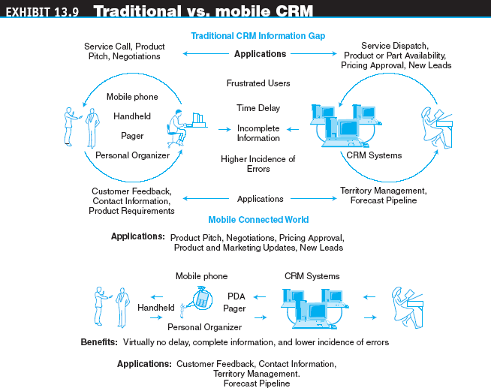
Delivering Customer Service in Cyberspace: CRM Applications and Tools

Slide 46
Other EC Support Services
Consulting Services
CRM Suites
  Directory services
  Newsletters
  Search engines and news aggregators

Slide 47
Other EC Support Services
More EC Support Services
Trust services
Trademark and domain names
Digital photos
Global business communities
Access to commercial databases
Online consulting
Knowledge management
Client matching
E-business rating sites
Security and encryption sites
Web research services
Coupon-generating sites

Slide 48
Outsourcing EC Support Services
Why Outsource EC Services?
  A desire to concentrate on the core business
  The need to have services up and running rapidly
  Lack of expertise (for many of the required support services)
  High costs for in-house options
  Inability to keep up with rapidly fluctuating demands if an in-house option is used
  The number of required services usually too many for one company to handle

Slide 49
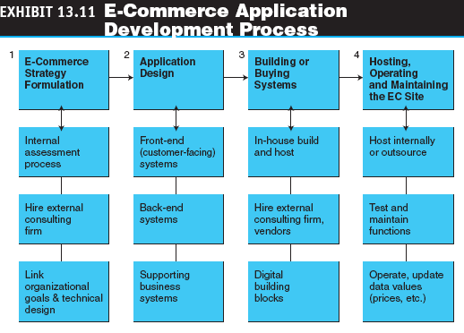
Outsourcing EC Support Services

Slide 50
Outsourcing EC Support Services
application service provider (ASP)
An agent or vendor who assembles the functions needed by enterprises and packages them with outsourced development, operation, maintenance, and other services
on-demand CRM
CRM hosted by an ASP or other vendor on the vendor’s premise; in contrast to the traditional practice of buying the software and using it on-premise

Slide 51
Managerial Issues
Have we planned for order fulfillment?
How should we handle returns?
Do we want alliances in order fulfillment?
What EC logistics applications would be useful?
How is our response time?
How do we measure and improve customer service?

Slide 52
Managerial Issues
Is CRM for real? How can it be justified?
Do we have to use electronically supported CRM?
EC consultants are expensive. Should we use them?
Should we outsource EC services?
Can we integrate CRM?

